Slide 1
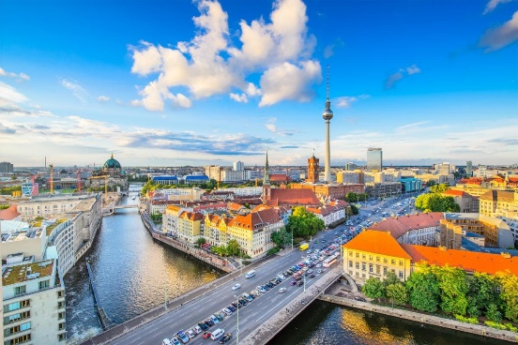
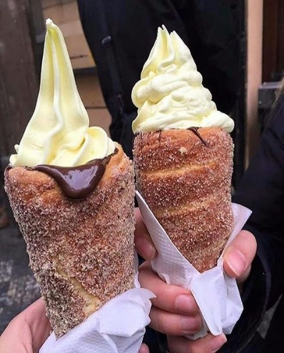
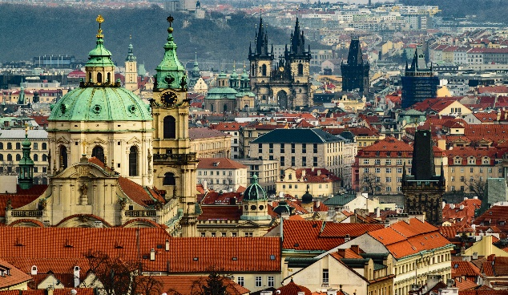
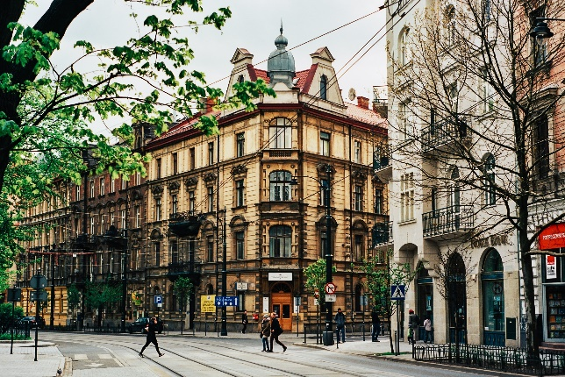
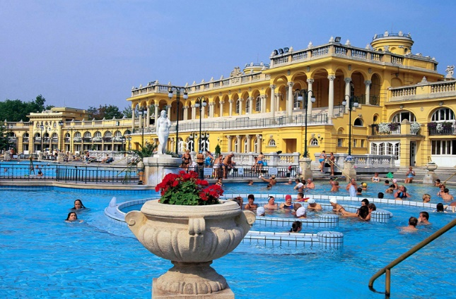
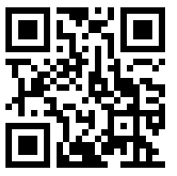
Congratulations!
You’re invited to travel with us on a unique and experiential international tour to Berlin, Prague, Krakow & Budapest during Spring Break of 2021! International travel is the best way to learn about new cultures, meet people from different backgrounds, and create life-long memories with your friends. Join us! It will surely be the highlight of your year.
Learn more about this exciting opportunity at an information meeting where we’ll discuss:
What we’ll see and do
Travel logistics
How to earn high school/college credit
Affordable payment options
And more
See you at the meeting!
PLEASE
RSVP TO FAMILY
MEETING
Alana Jevert
P.S. Can’t make the meeting but want more information?
Send me an email at jeverta@nclack.k12.or.us
Meeting Info and RSVP here - https://rsvp.eftours.com/e8xs59r
All rsvp’s due by Friday, Nov. 15th

